Slide 1

E-Plushie: Textile turned waste plushies
TEAM MLLF
Van Emerson A. Francisco
Mark Vincent Minon
Ezekiel Labaco

Slide 2
Introduction

Slide 3
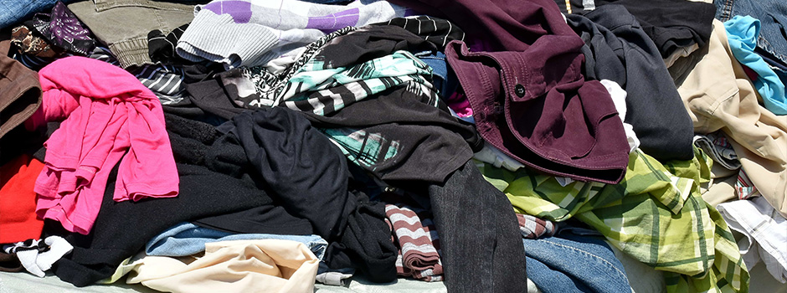
TEXTILE RECYCLING
is the process of gathering recovering fiber, yarn, or fabric for further material use or turning them into useful products. Textile waste products are gathered from different sources and are then sorted and processed depending on their condition. Textile industry has played a significant part in developing economic idea and technology.
In the present world today the concept textile recycling is unaware that it has been existing for decades.
This Photo by Unknown Author is licensed under CC BY

Slide 4
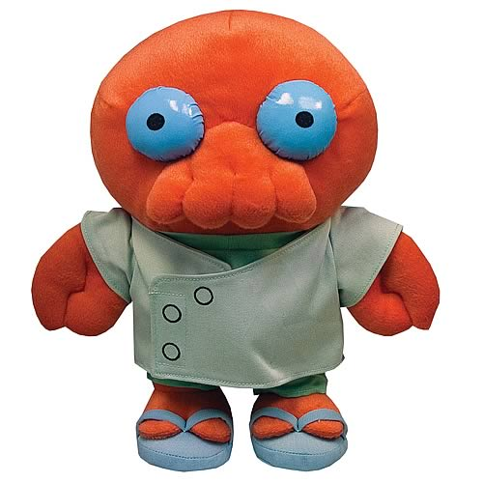
WHAT IS A STUFFED TOY?
Stuffed toy is a sewn material that is made from cloth, and filled with a soft component. They are also referred to as plush toys, plushies, or stuffed animals, as well as soft or cuddly toys.
These plushies they are frequently given as presents for some occasions or to express one’s feelings of love and they might be displayed or collected.
This Photo by Unknown Author is licensed under CC BY-SA-NC

Slide 5
Why are we telling this?

Slide 6

PURPOSE AND DESCRIPTION: KARAW CRAFTVENTURES
Karaw Craftventures, a social enterprise that has an advocacy in promoting upcycling and promoting local filipino artisans (particularly in Bicol). They sell variety of gifts that are upcycled and made by their artisans, ranging from women inmates to mothers in Bicol.
Through their enterprise they provide jobs and new skills training through their creation of products that they sell

Slide 7


PURPOSE AND DESCRIPTION : KARAW CRAFTVENTURE’S PROBLEM
Karaw Craftventures accepts customized plushie works to customers around metro manila but encounters problem regarding the prototyping of their customer’s product in terms of timeframe. Also, Karaw Craftventures also has a hard time in understanding the vision of their customers in their product.
This Photo by Unknown Author is licensed under CC BY-SA
This Photo by Unknown Author is licensed under CC BY-NC-ND

Slide 8
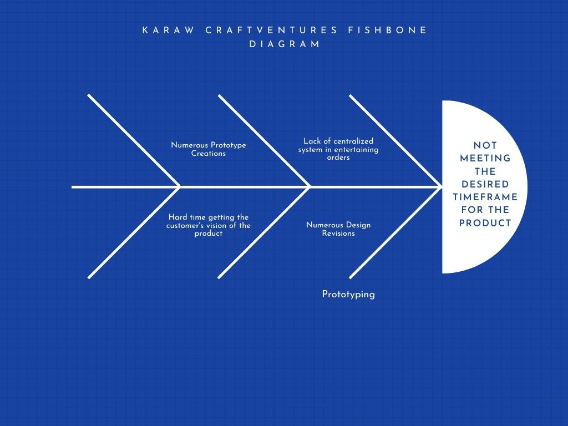
FISHBONE DIAGRAM (KARAW CRAFTVENTURES)

Slide 9
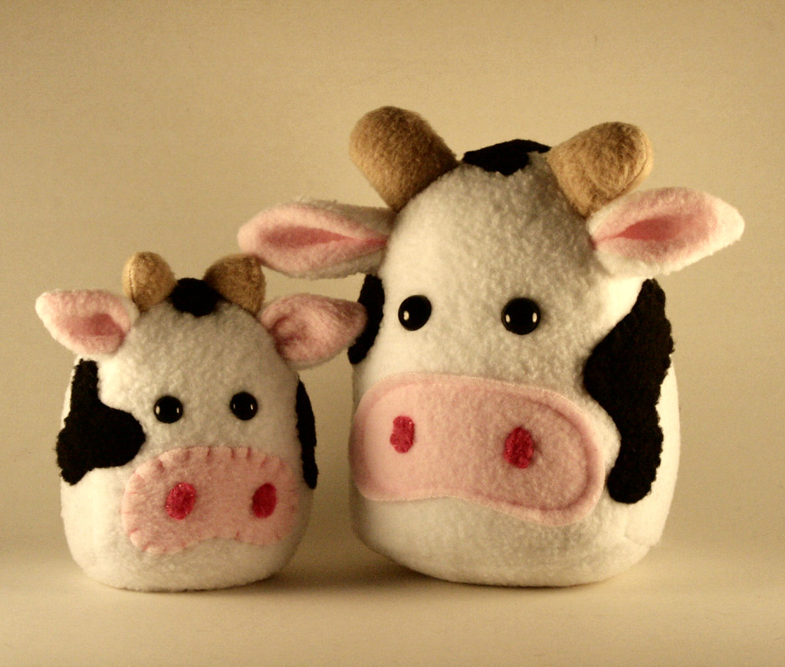
PROJECT CONTEXT: E-PLUSHIE
With the problem that the client is encountering, the researchers are planning to develop a plushie customizing system with an integration of web and mobile.
The main goal of the system is to determine and understand their customer’s vision and preferences. They can also optimize the work time needed for the customized plushie that will be created.
This Photo by Unknown Author is licensed under CC BY-SA-NC

Slide 10
E-PLUSHIE OBJECTIVES
E-Plushie’s objective is to provide a system for Karaw Craftventures, A Upcycling business that manufactures upcycled gifts such as Plushies and etc. Karaw Craftventures, the company that we are providing for, also has an advocacy of promoting upcycling of materials and promoting local Filipino artisans.

Slide 11
E-PLUSHIE OBJECTIVES
This are the specific objectives of this project:
To create a web and mobile plushie customization module.
To create a login and logout module for monitoring of custom creations.
To create a payment module for procurement payment of customized plushies.
To create a shopping cart module for selling pre-made plushies created by the organization.
To create a plushie progress tracking module for customers’ to check their plushie’s completion.
To create an administrative module for account monitoring and content management of the system.

Slide 12
SCOPES AND DELIMITATIONS
Plushie Customization Module – allows users in the system to make customized plushies, part by part. The users will be offered a set of parts in the system that they can mix and match according to their preferences.
Shopping Cart Module – allows users in the system to buy premade plushies created by the client with a fair amount of price.
Payment Module – Caters all the payment made in the system. It shows the breakdown of all the production cost of the items acquired by the user. It also gives the user some options in terms of payment methods and shipping methods.

Slide 13
SCOPES AND DELIMITATIONS
Login and Logout Module – Allows users to register in the system and access the customization and transaction modules provided by the system. The requirements needed for registration in the system consists of username, password, verified email and a mobile number.
Plushie Progress Tracking Module – This module tracks the progress of the creation of the customized plushie the user has created. In every completion of progress, the user will be sent an email or a text message that the plushie has completed a certain phase.
Administrative Module – This module allows the organization to monitor account movement and also allows the client to manage content that are placed inside the system.

Slide 14

Significance of the Study
The primary beneficiaries of this study are:
The Organization
This Photo by Unknown Author is licensed under CC BY-NC-ND

Slide 15

Significance of the Study
The Customers / Users
This Photo by Unknown Author is licensed under CC BY-SA-NC

Slide 16

Significance of the Study
The Future Researchers
This Photo by Unknown Author is licensed under CC BY

Slide 17
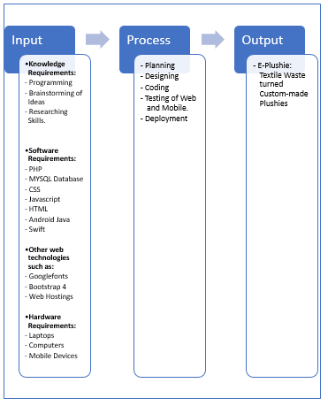
Conceptual Framework

Slide 18
Chapter 2

Slide 19
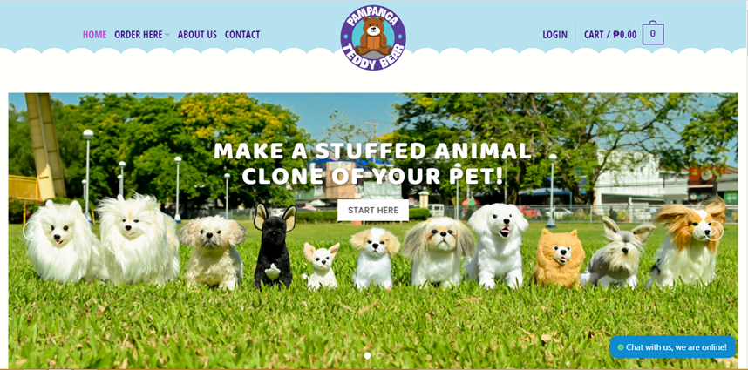
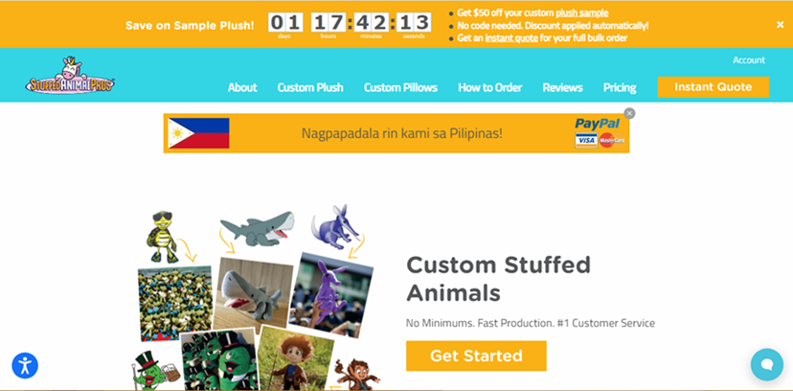
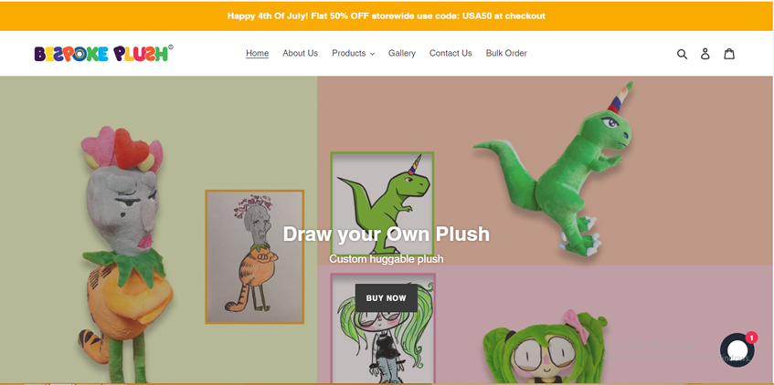
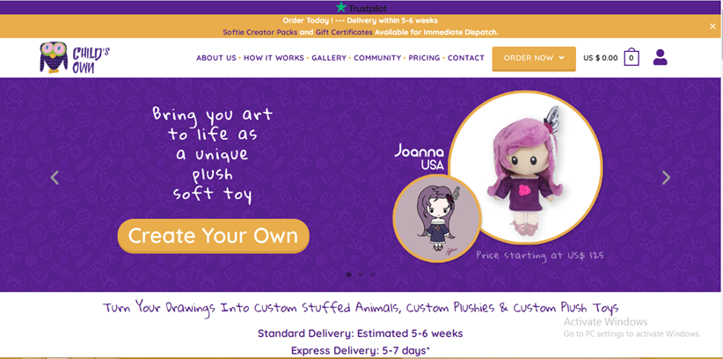
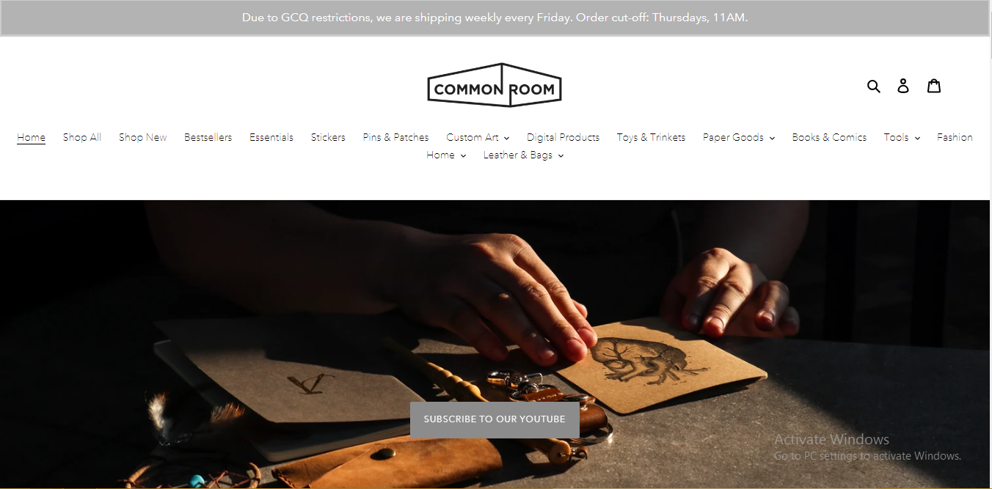
Teddy.ph
StuffAnimalPros
Bespoke Plushie
Child’s Own
Common Room PH

Slide 20
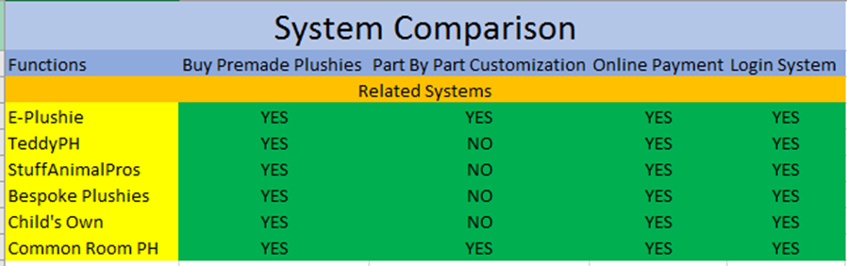
SYNTHESIS

Slide 21
CHAPTER 3

Slide 22
DATA FLOW DIAGRAM
Updated Prices
8.0
Modify Prices
7.0
Add/Remove
Plushie Design
Customize Plushie
1.0
Customize
Plushies
Order
4.0
Checkout
Transaction Record
Admin
9.0
Manage Accounts
Database
User
Buy Plushies
2.0
Buy Premade
Plushies
Order
Design Specifications
5.0
Retrieve Design Specifications
6.0
Update Tracking Order
3.0
Track Order
Progress Update
Track Order
Artisan
Account Concerns

Slide 23
USE CASE DIAGRAM
E-Plushie Web
Login / Logout Account
Receive Plushie Design Specification
Register Account
Artisan
Customize Plushie Design
Check Out
View Order
Manage Account
Browse Pre-made Plushies
User
Track Order
Add and Remove Plushie Design
Admin

Slide 24
USE CASE DIAGRAM
E-Plushie Mobile
Login / Logout Account
Register Account
Receive Plushie Design Specification
Customize Plushie Design
View Order
Check Out
Browse Pre-made Plushies
Artisan
User
Track Order

Slide 25
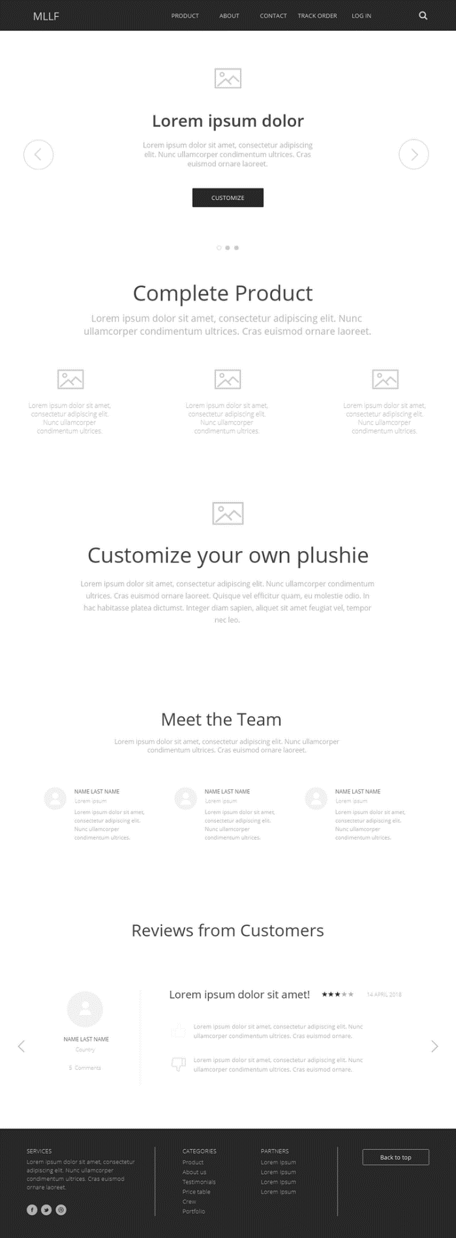
USER INTERFACE DESIGN (WEB)
MAIN PAGE

Slide 26
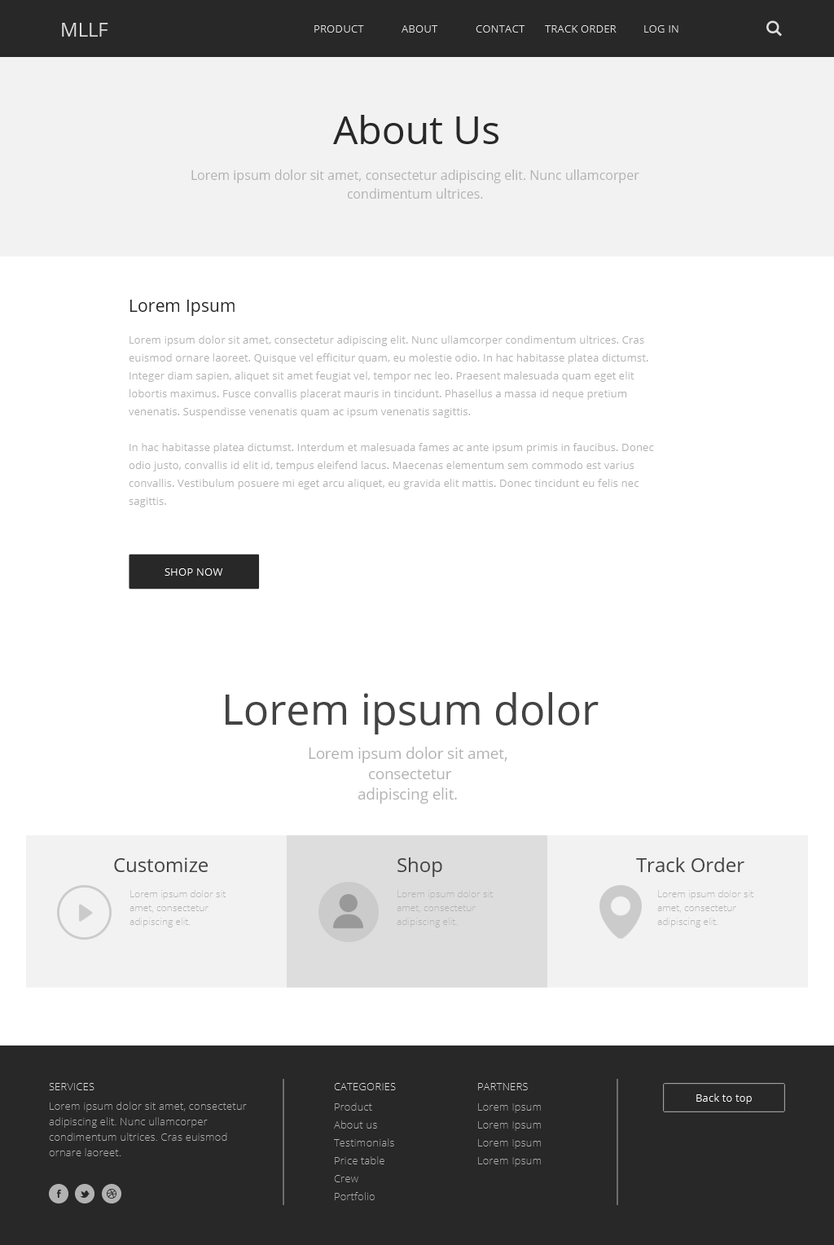
USER INTERFACE DESIGN (WEB)
ABOUT US PAGE

Slide 27
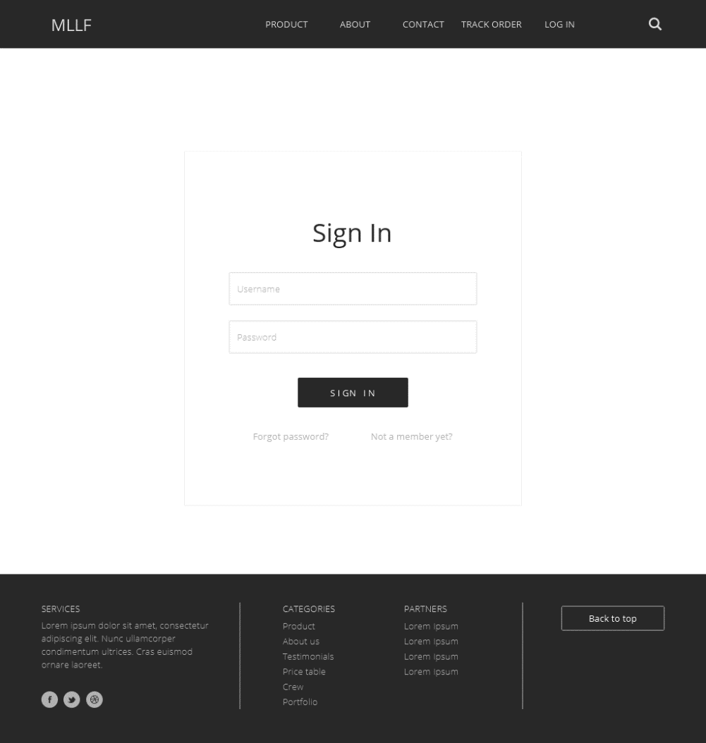
USER INTERFACE DESIGN (WEB)
SIGN IN PAGE

Slide 28
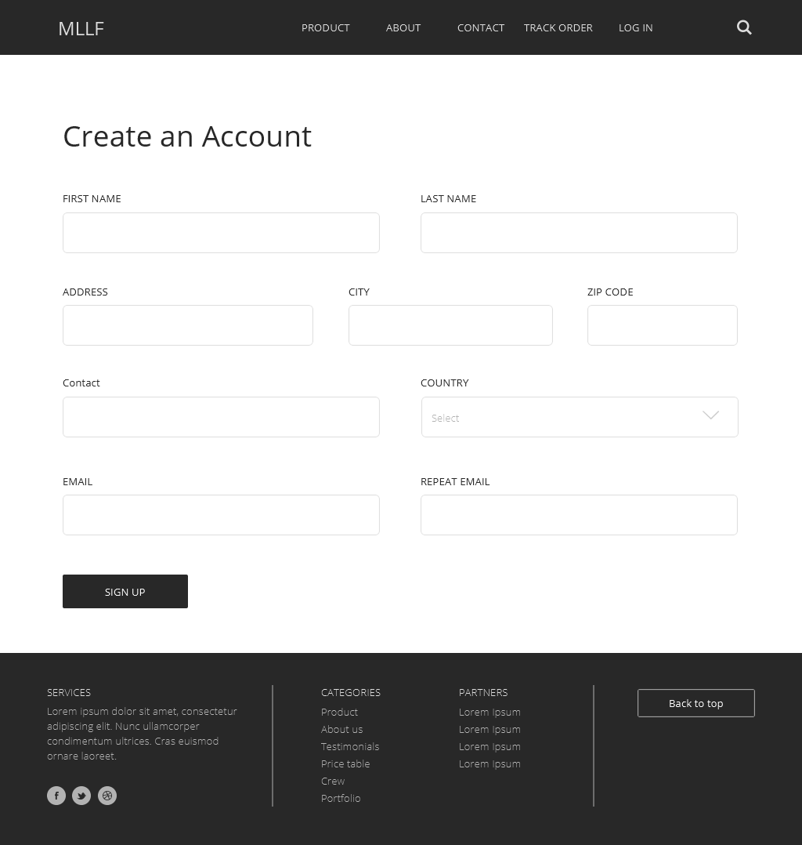
USER INTERFACE DESIGN (WEB)
SIGN UP PAGE

Slide 29
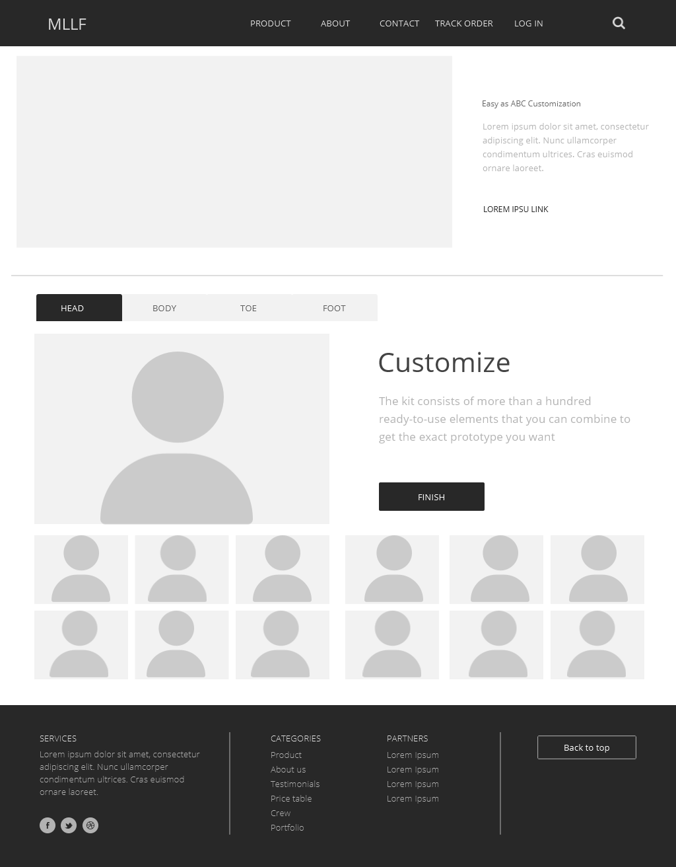
USER INTERFACE DESIGN (WEB)
CUSTOMIZATION PAGE

Slide 30
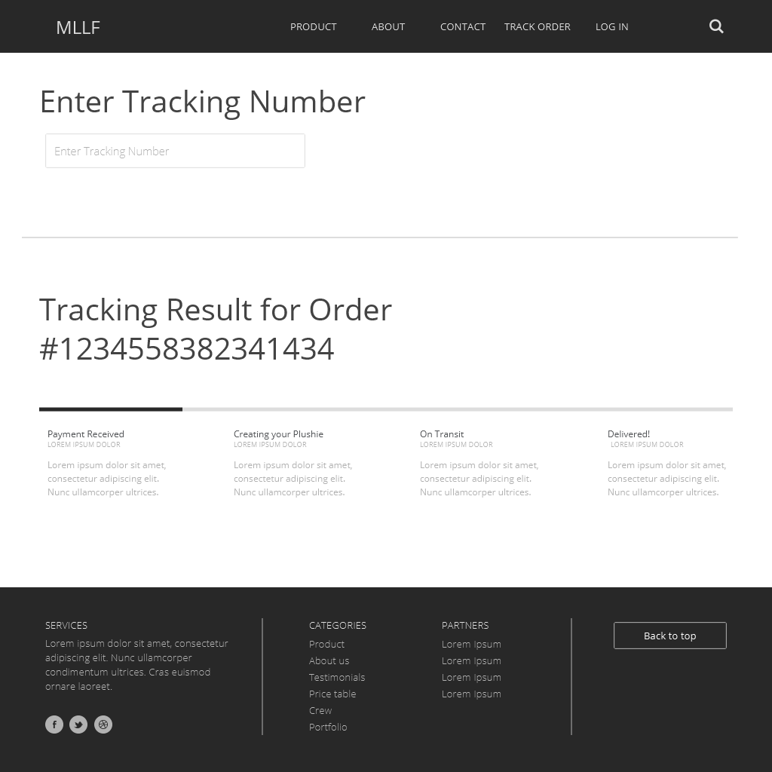
USER INTERFACE DESIGN (WEB)
TRACKING ORDER PAGE

Slide 31
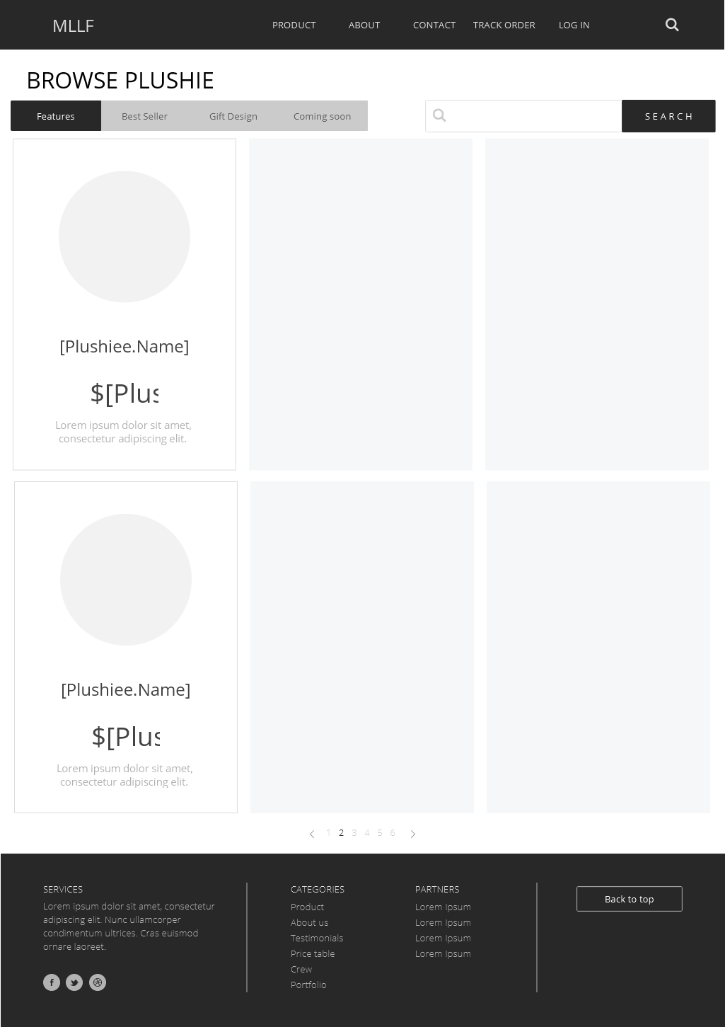
USER INTERFACE DESIGN (WEB)
SHOPPING CART PAGE

Slide 32
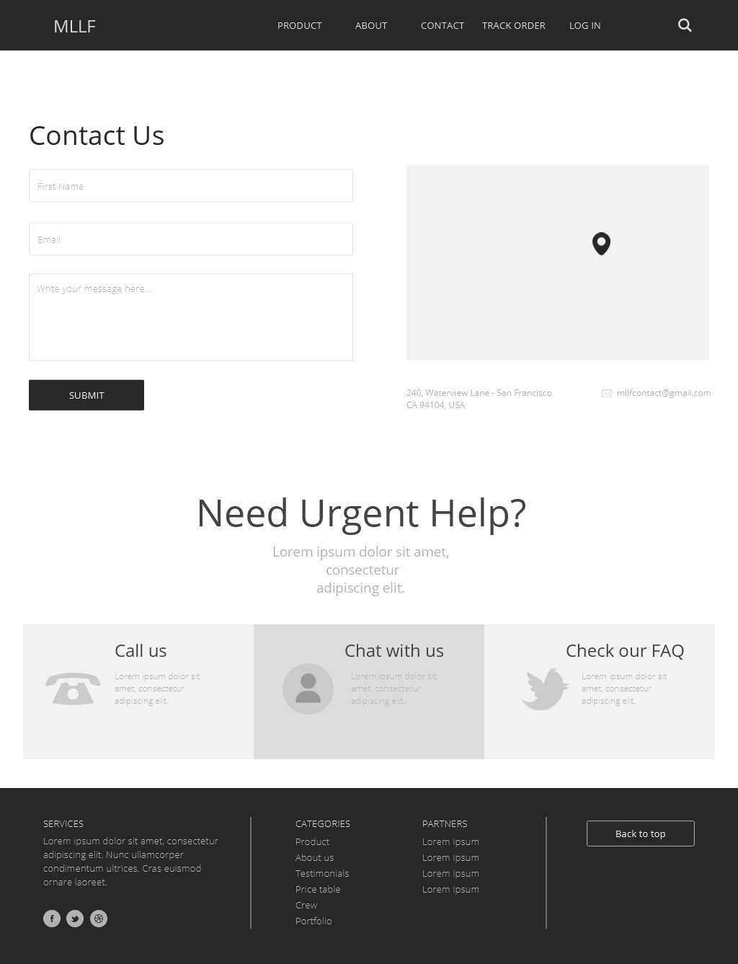
USER INTERFACE DESIGN (WEB)
SHOPPING CART PAGE

Slide 33
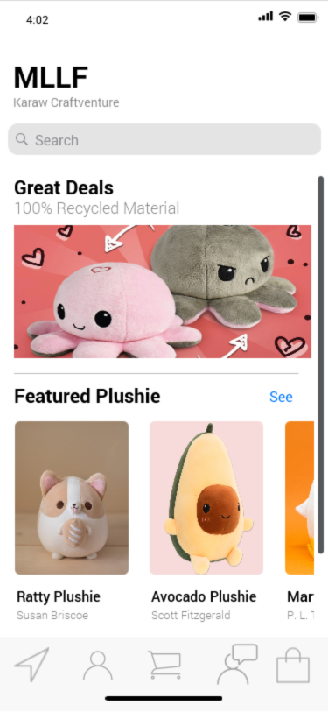
USER INTERFACE DESIGN (MOBILE)
HOME & SHOPPING DESIGN

Slide 34
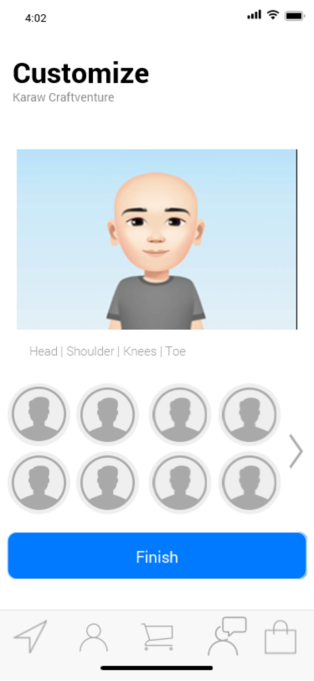
USER INTERFACE DESIGN (MOBILE)
CUSTOMIZATION

Slide 35
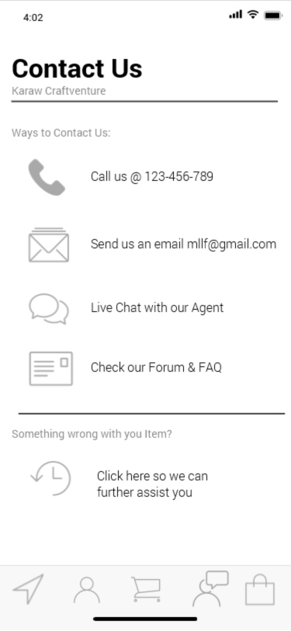
USER INTERFACE DESIGN (MOBILE)
CONTACT US

Slide 36
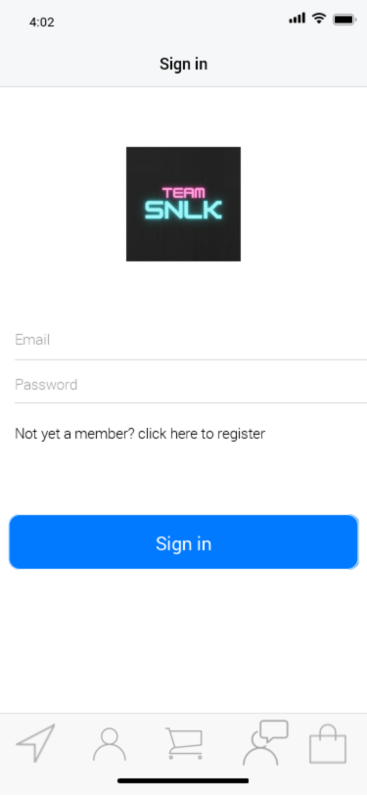
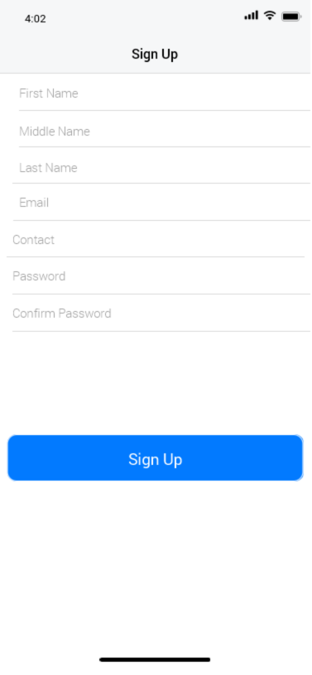
USER INTERFACE DESIGN (MOBILE)
SIGN IN & SIGN UP

Slide 37
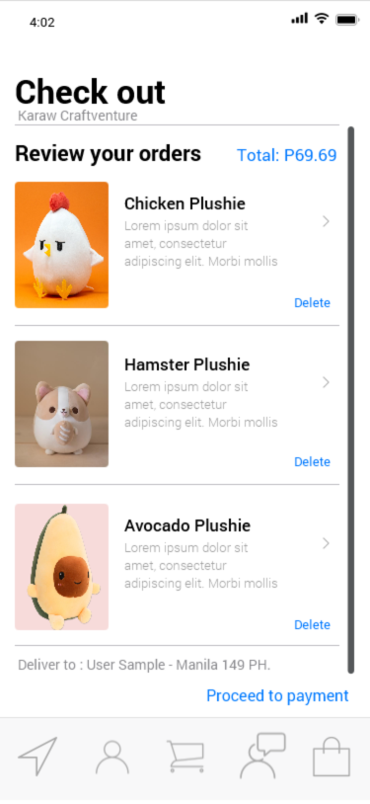
USER INTERFACE DESIGN (MOBILE)
CHECK OUT

Slide 38
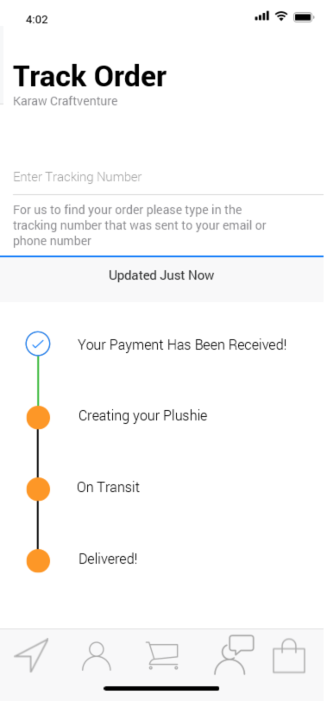
USER INTERFACE DESIGN (MOBILE)
TRACK ORDER

Slide 39
THANK YOU!

